Slide 1

Optimization Algorithms
Mini-batch
gradient descent
deeplearning.ai

Slide 2
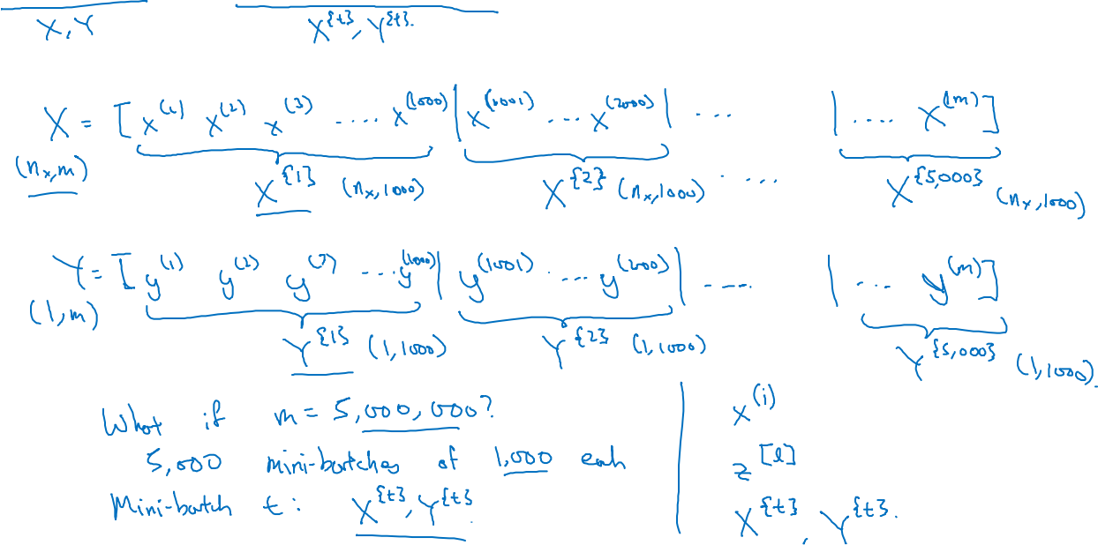
Batch vs. mini-batch gradient descent
Vectorization allows you to efficiently compute on m examples.

Slide 3
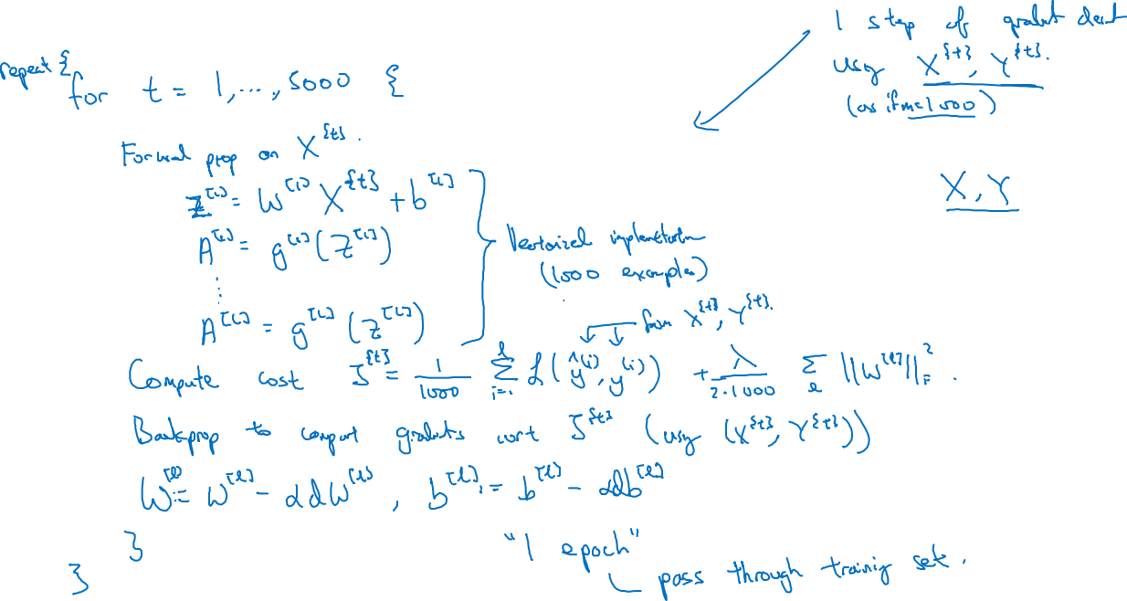
Mini-batch gradient descent

Slide 4
Optimization Algorithms
Understanding
mini-batch
gradient descent
deeplearning.ai

Slide 5
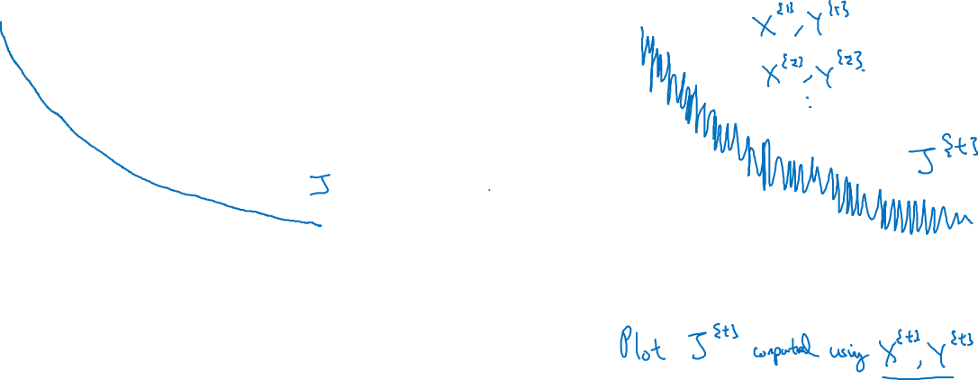
Training with mini batch gradient descent
Batch gradient descent
Mini-batch gradient descent
cost
cost
# iterations
mini batch # (t)

Slide 6
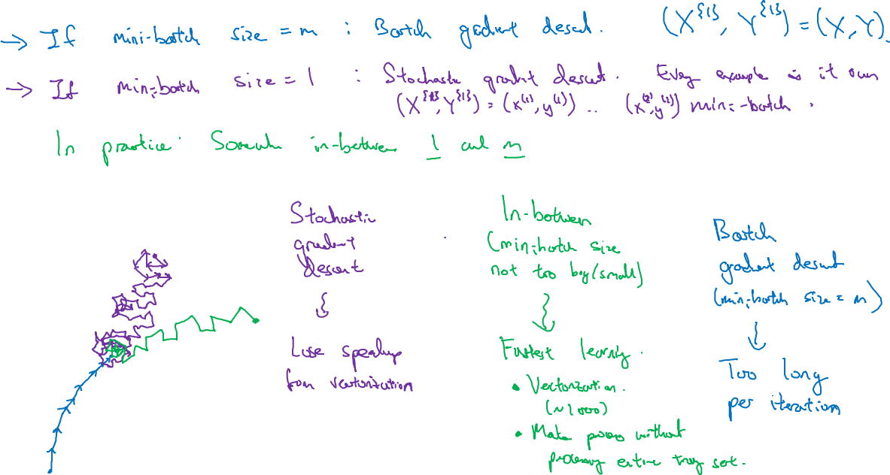
Choosing your mini-batch size

Slide 7
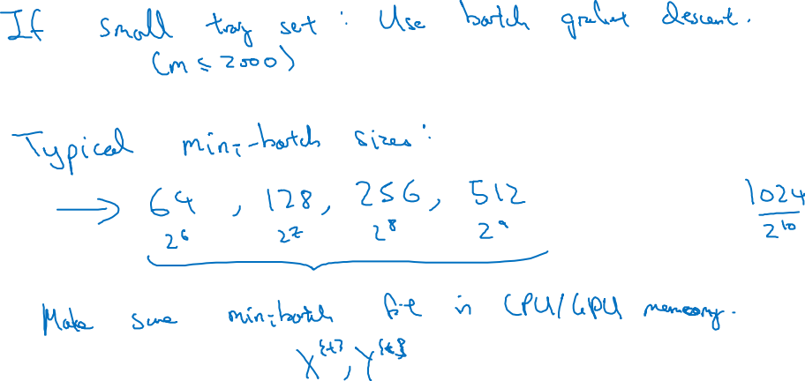
Choosing your mini-batch size

Slide 8
Optimization Algorithms
Exponentially weighted averages
deeplearning.ai

Slide 9
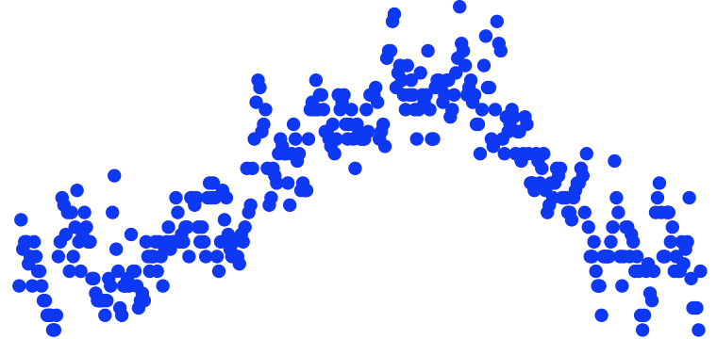
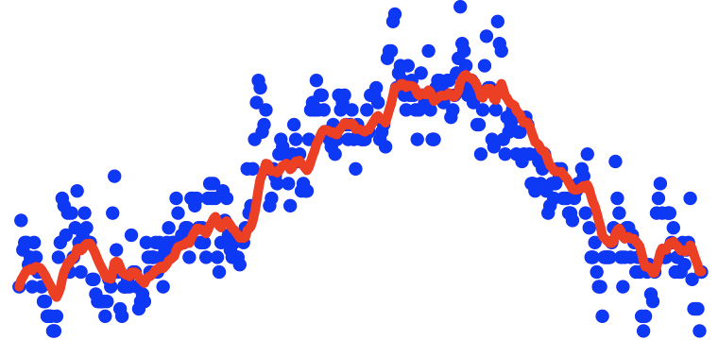
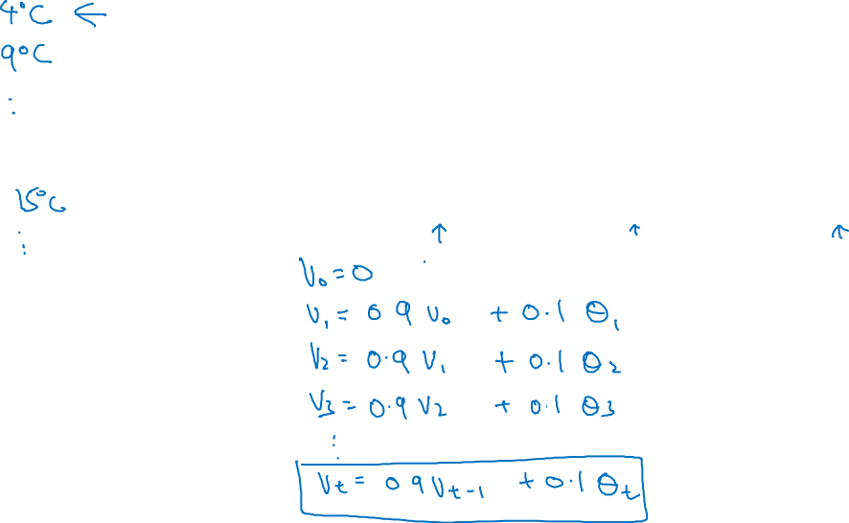
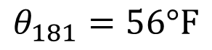
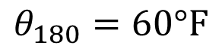
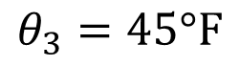
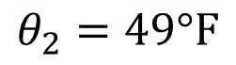
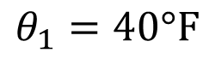
Temperature in London
$$θ_{1}=40°F$$
$$θ_{2}=49°F$$
$$θ_{3}=45°F$$
temperature
.
.
.
$$θ_{180}=60°F$$
$$θ_{181}=56°F$$
days
.
.
.

Slide 10
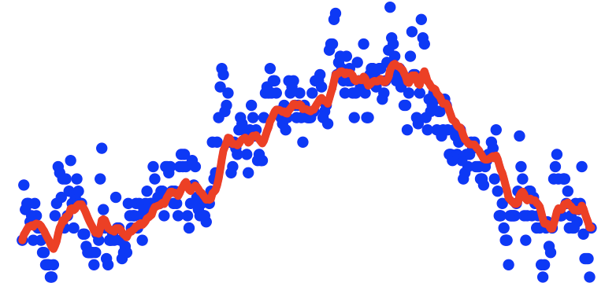
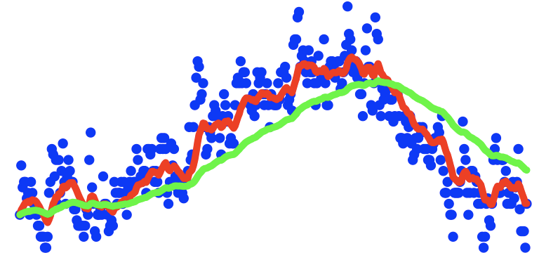
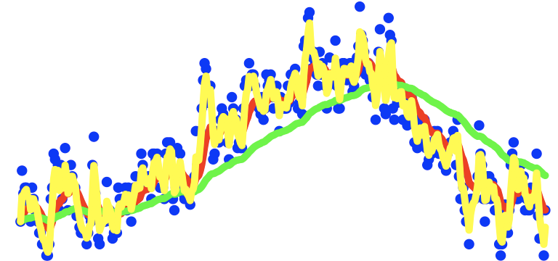
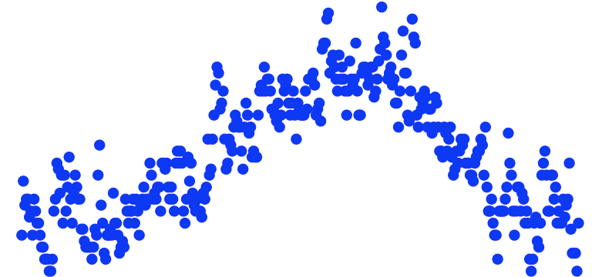
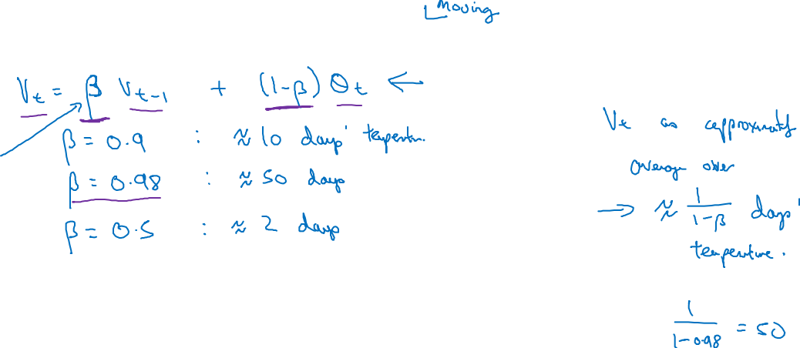
Exponentially weighted averages
temperature
days

Slide 11
Optimization Algorithms
Understanding exponentially weighted averages
deeplearning.ai

Slide 12
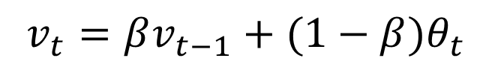
Exponentially weighted averages
$$v_{t}=βv_{t−1}+(1−β)θ_{t}$$
temperature
days

Slide 13
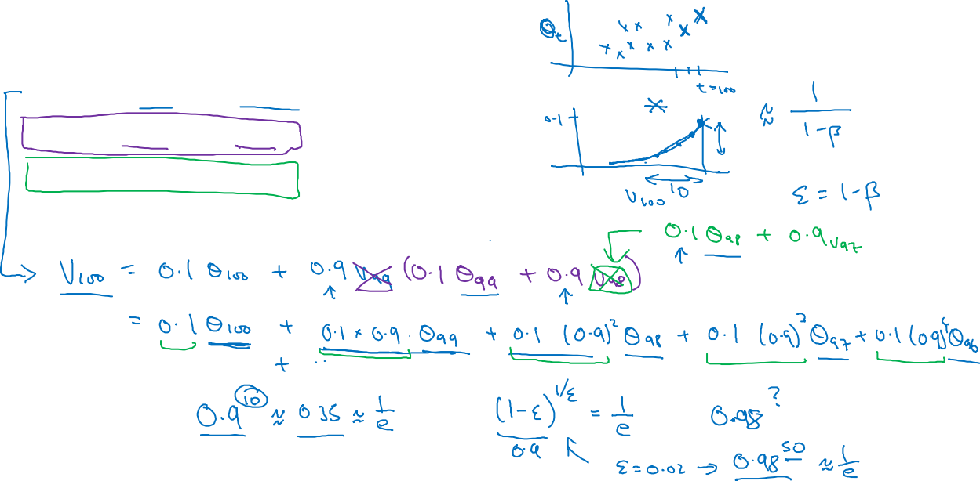
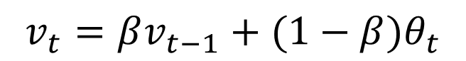

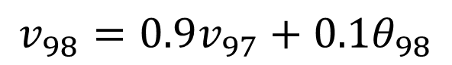
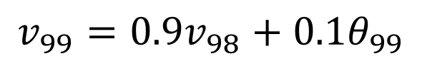
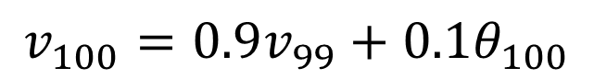
Exponentially weighted averages
$$v_{t}=βv_{t−1}+(1−β)θ_{t}$$
$$v_{100}=0.9v_{99}+0.1θ_{100}$$
$$v_{99}=0.9v_{98}+0.1θ_{99}$$
$$v_{98}=0.9v_{97}+0.1θ_{98}$$
$$…$$

Slide 14
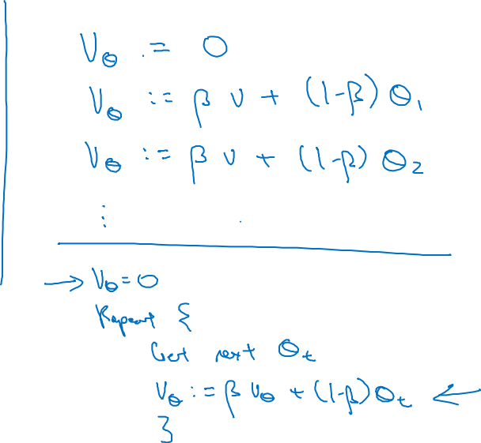
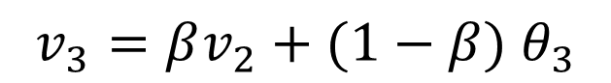
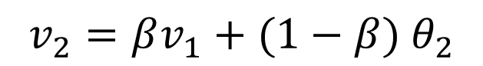

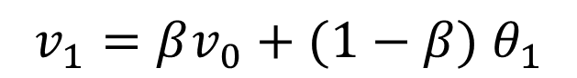
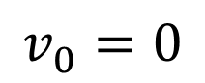
Implementing exponentially weighted averages
$$v_{0}=0$$
$$v_{1}=βv_{0}+(1−β) θ_{1}$$
$$v_{2}=βv_{1}+(1−β) θ_{2}$$
$$v_{3}=βv_{2}+(1−β) θ_{3}$$
$$…$$

Slide 15
Optimization Algorithms
Bias correction
in exponentially
weighted average
deeplearning.ai

Slide 16
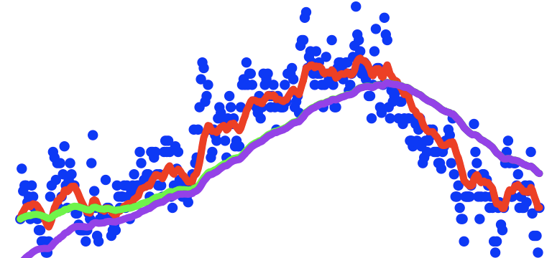
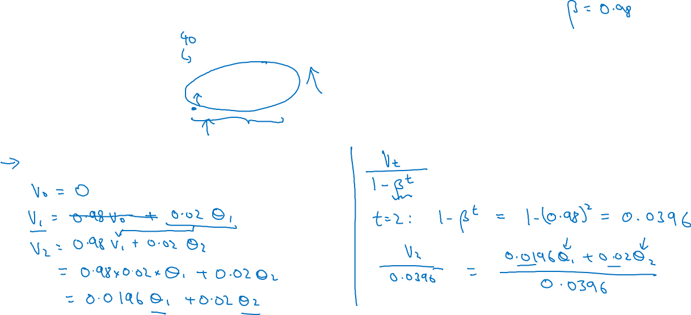
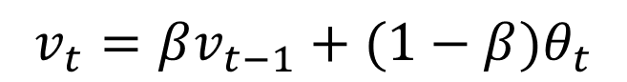
Bias correction
temperature
days
$$v_{t}=βv_{t−1}+(1−β)θ_{t}$$

Slide 17
Optimization Algorithms
Gradient descent with momentum
deeplearning.ai

Slide 18
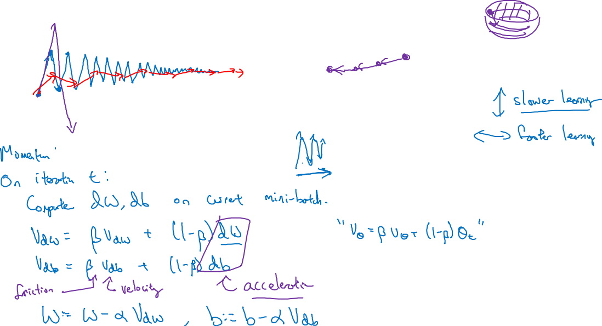
Gradient descent example

Slide 19
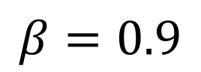
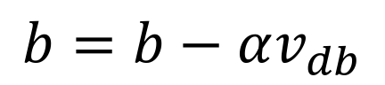
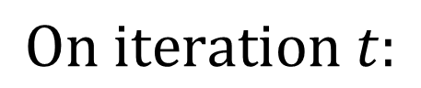
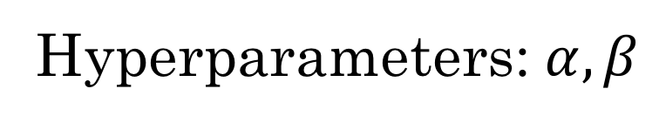
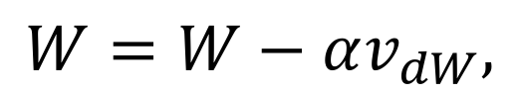
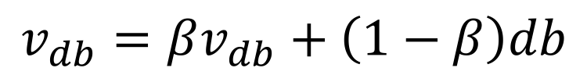
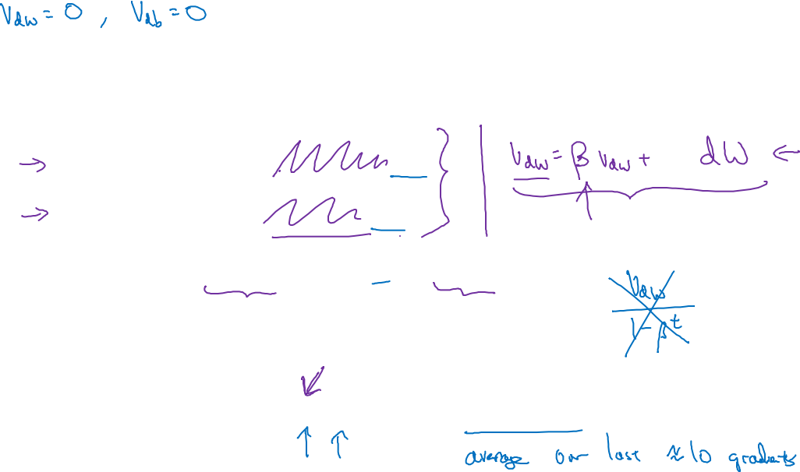
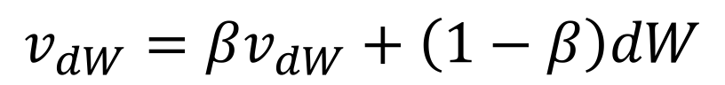
Implementation details
$$On iteration t:$$
Compute $dW,db$on the current mini-batch
$$v_{dW}=βv_{dW}+\left(1−β\right)dW$$
$$v_{db}=βv_{db}+\left(1−β\right)db$$
$$W=W−αv_{dW},$$
$$b=b−αv_{db}$$
Hyperparameters: $α,β$
$$β=0.9$$

Slide 20
Optimization Algorithms
RMSprop
deeplearning.ai

Slide 21
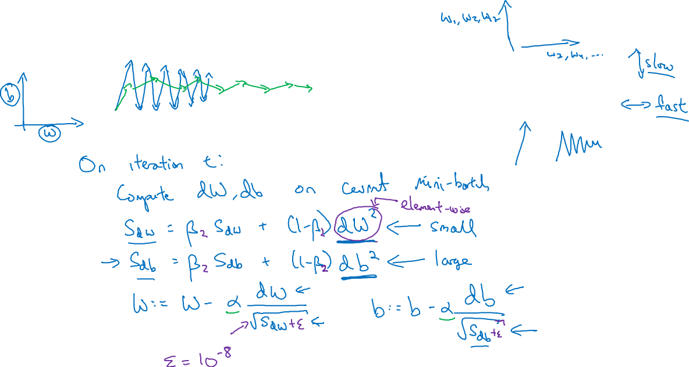
RMSprop

Slide 22
Optimization Algorithms
Adam optimization
algorithm
deeplearning.ai

Slide 23
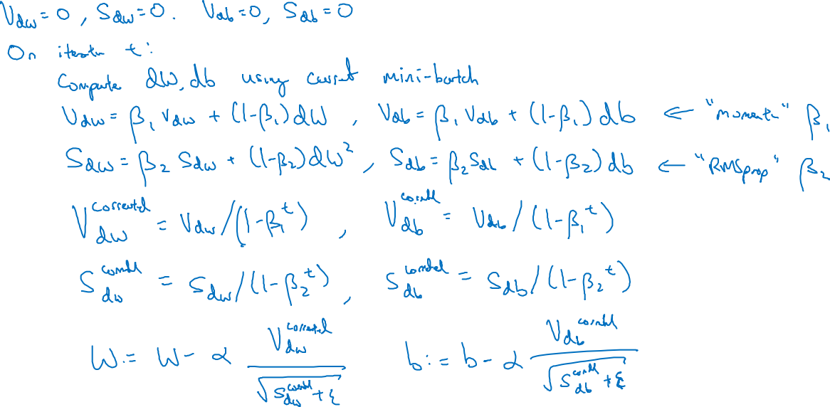
Adam optimization algorithm
yhat = np.array([.9, 0.2, 0.1, .4, .9])

Slide 24

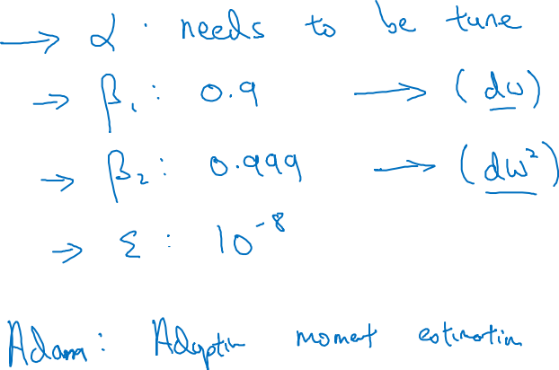
Hyperparameters choice:
Adam Coates

Slide 25
Optimization Algorithms
Learning rate
decay
deeplearning.ai

Slide 26
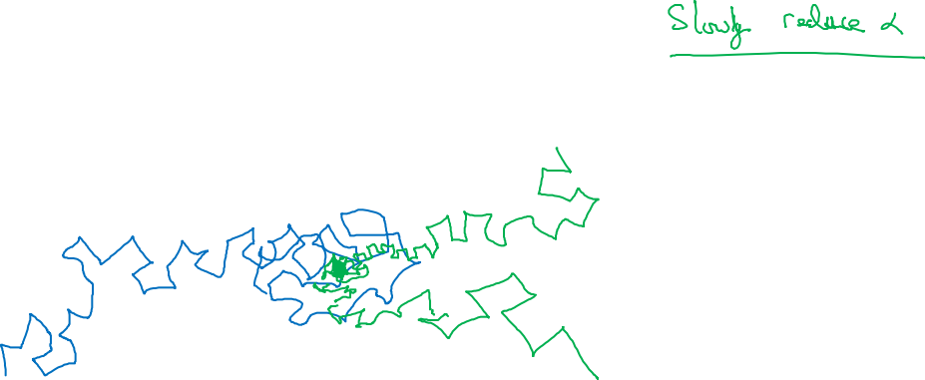
Learning rate decay

Slide 27
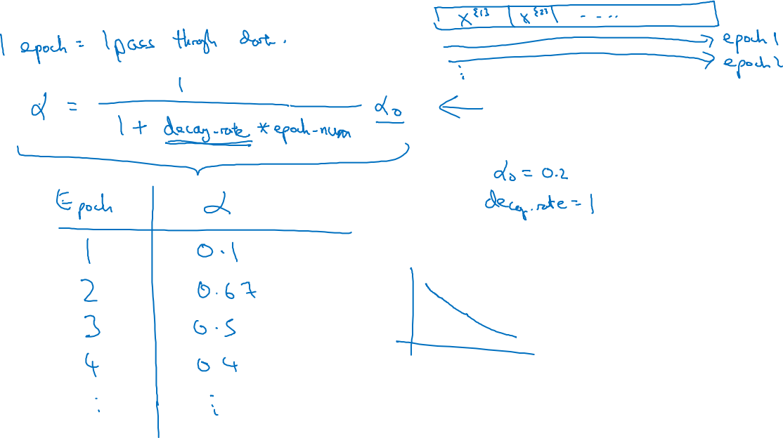
Learning rate decay

Slide 28
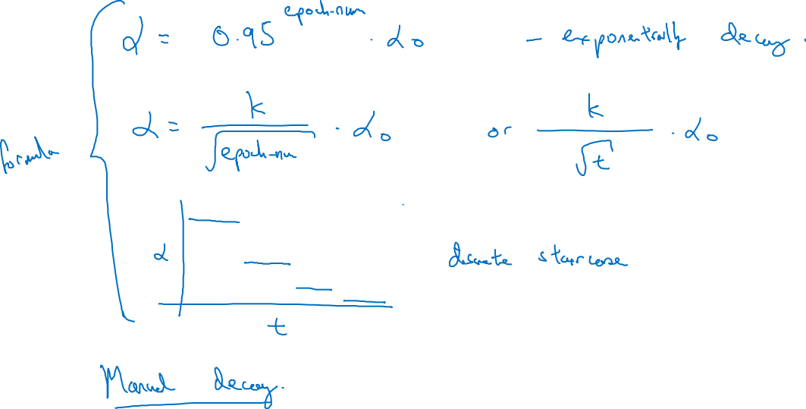
Other learning rate decay methods

Slide 29
Optimization Algorithms
The problem of
local optima
deeplearning.ai

Slide 30
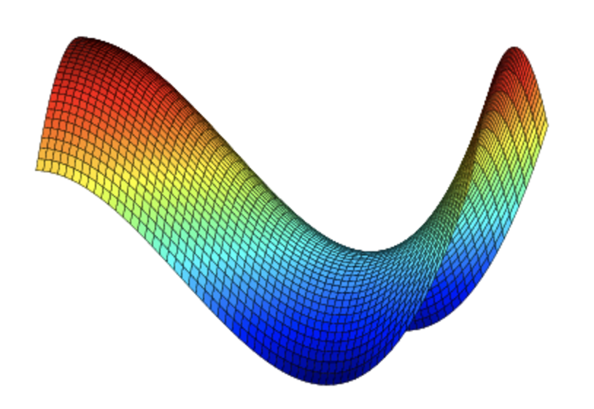
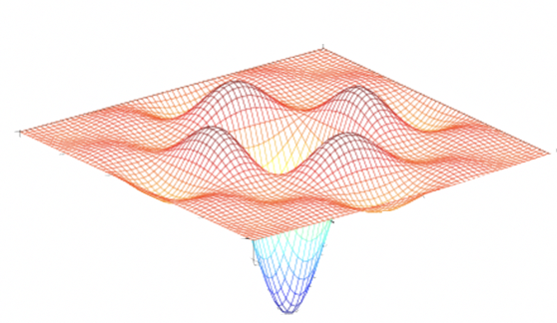
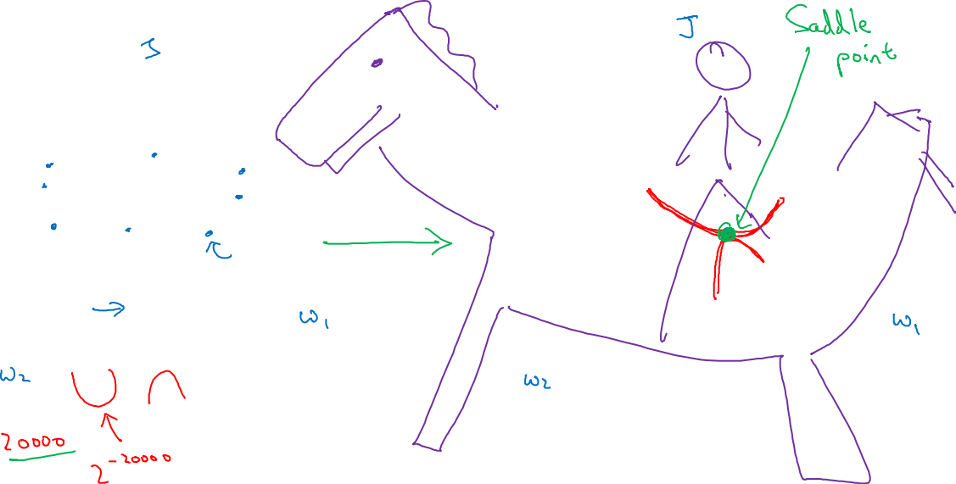
Local optima in neural networks

Slide 31


Problem of plateaus
Unlikely to get stuck in a bad local optima
Plateaus can make learning slow

Slide 32
Hyperparameter tuning
Tuning process
deeplearning.ai

Slide 33

Hyperparameters

Slide 34

Try random values: Don’t use a grid
Hyperparameter 2
Hyperparameter 2
Hyperparameter 1
Hyperparameter 1

Slide 35

Coarse to fine
Hyperparameter 2
Hyperparameter 1

Slide 36
Hyperparameter tuning
Using an appropriate scale to pick hyperparameters
deeplearning.ai

Slide 37

Picking hyperparameters at random

Slide 38

Appropriate scale for hyperparameters

Slide 39

Hyperparameters for exponentially weighted averages

Slide 40
Hyperparameters tuning
Hyperparameters
tuning in practice:
Pandas vs. Caviar
deeplearning.ai

Slide 41


Re-test hyperparameters occasionally
Idea
NLP, Vision, Speech,
Ads, logistics, ….
Intuitions do get stale. Re-evaluate occasionally.
Experiment
Code

Slide 42


Babysitting one model
Training many models in parallel
Panda
Caviar

Slide 43
Batch Normalization
Normalizing activations
in a network
deeplearning.ai

Slide 44










Normalizing inputs to speed up learning
$$x_{1}$$
$$w,b$$
$$x_{2}$$
$$\hat{y}$$
$$x_{3}$$
$$x_{1}$$
$$x_{2}$$
$$\hat{y}$$
$$x_{3}$$

Slide 45

Implementing Batch Norm

Slide 46
Batch Normalization
Fitting Batch Norm
into a neural network
deeplearning.ai

Slide 47





Adding Batch Norm to a network
$$x_{1}$$
$$x_{2}$$
$$\hat{y}$$
$$x_{3}$$

Slide 48

Working with mini-batches

Slide 49

Implementing gradient descent

Slide 50
Batch Normalization
Why does
Batch Norm work?
deeplearning.ai

Slide 51






Learning on shifting input distribution
$$x_{1}$$
$$x_{2}$$
$$\hat{y}$$
$$x_{3}$$
Cat
$$y = 1$$
Non-Cat
$$y =0$$
$$y = 1$$
$$y =0$$

Slide 52





Why this is a problem with neural networks?
$$x_{1}$$
$$x_{2}$$
$$\hat{y}$$
$$x_{3}$$

Slide 53


Batch Norm as regularization
Each mini-batch is scaled by the mean/variance computed on just that mini-batch.
This adds some noise to the values $z^{[l]}$ within that minibatch. So similar to dropout, it adds some noise to each hidden layer’s activations.
This has a slight regularization effect.

Slide 54
Batch Normalization
Batch Norm at
test time
deeplearning.ai

Slide 55





Batch Norm at test time
$$μ=\frac{1}{m}\sum_{i}{z^{(i)}}$$
$$σ^{2}=\frac{1}{m}\sum_{i}{{{(z}^{(i)}−μ)}^{2}}$$
$$z_{norm}^{(i)}=\frac{z^{(i)}−μ}{\sqrt{σ^{2}+ε}}$$
$${{\tilde{z}}^{(i)}=γz}_{norm}^{(i)}+β$$

Slide 56
Multi-class classification
Softmax regression
deeplearning.ai

Slide 57

Recognizing cats, dogs, and baby chicks
3
1
2
0
3
2
0
1
X
$$\hat{y}$$

Slide 58

Softmax layer
X
$$\hat{y}$$

Slide 59


















Softmax examples
$$x_{2}$$
$$x_{2}$$
$$x_{2}$$
$$x_{1}$$
$$x_{1}$$
$$x_{1}$$
$$x_{2}$$
$$x_{2}$$
$$x_{2}$$
$$x_{1}$$
$$x_{1}$$
$$x_{1}$$

Slide 60
Multi-class classification
Trying a softmax
classifier
deeplearning.ai

Slide 61
Understanding softmax

Slide 62
Loss function

Slide 63
Summary of softmax classifier
X
$$\hat{y}$$

Slide 64
Programming Frameworks
Deep Learning frameworks
deeplearning.ai

Slide 65
Deep learning frameworks
Choosing deep learning frameworks
Ease of programming (development and deployment)
Running speed
Truly open (open source with good governance)
Caffe/Caffe2
CNTK
DL4J
Keras
Lasagne
mxnet
PaddlePaddle
TensorFlow
Theano
Torch

Slide 66
Programming Frameworks
TensorFlow
deeplearning.ai

Slide 67

Motivating problem

Slide 68

Code example
import numpy as np
import tensorflow as tf
coefficients = np.array([[1], [-20], [25]])
w = tf.Variable([0],dtype=tf.float32)
x = tf.placeholder(tf.float32, [3,1])
cost = x[0][0]*w**2 + x[1][0]*w + x[2][0] # (w-5)**2
train = tf.train.GradientDescentOptimizer(0.01).minimize(cost)
init = tf.global_variables_initializer()
session = tf.Session()
session.run(init)
print(session.run(w))
for i in range(1000):
session.run(train, feed_dict={x:coefficients})
print(session.run(w))
with tf.Session() as session:
session.run(init)
print(session.run(w))

